Slide 1

Computer Systems Fundamentals
H175 34
Lecture 7
Operating System Software

Slide 2
Computer Operating Systems
What is an Operating System?
A program, or set of programs, to drive the hardware and provide an interface between the user and the computer
Why is it kept separate from the rest of the files and data on a computer?
To protect it and stop it from becoming corrupted, which would mean the computer would no longer work

Slide 3
Computer Operating Systems
In original computers, the operating system was not kept separate from all the other data and files in use.
This made it too vulnerable to being deleted or corrupted by other files, data or even users
Modern operating systems therefore have various levels of protection from outside factors
There are two main types of OS – Single User and Multi User

Slide 4
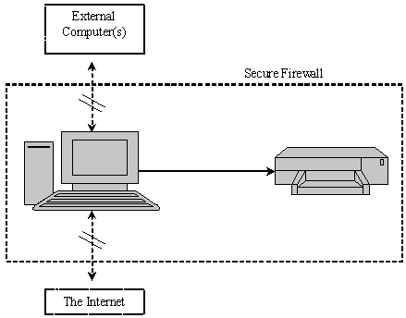
Single User Operating System
Single User operating systems allow only one user to make use of the computer at any given time. This is sometimes called a Stand-alone System.

Slide 5
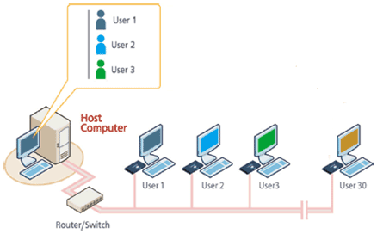
Multi User Operating System
Multi-User operating systems are nowadays usually used on networks. They allow many people to use the same computer system at once.

Slide 6
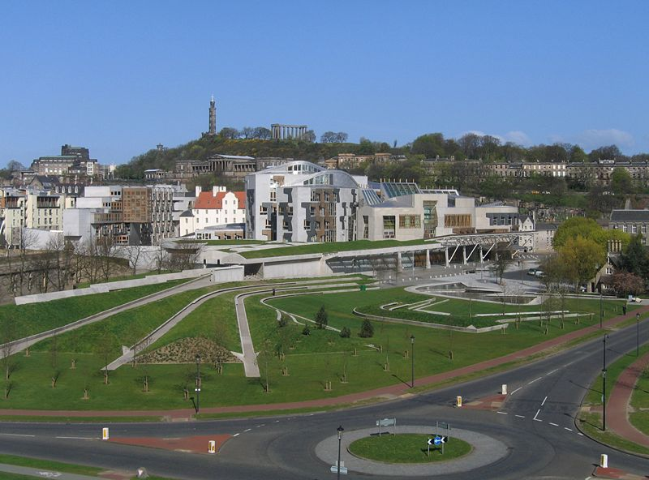
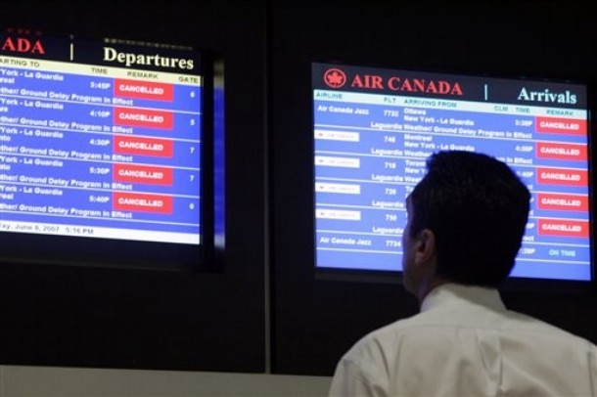

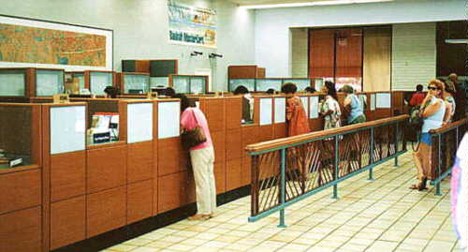
Examples of Multi User Systems

Slide 7
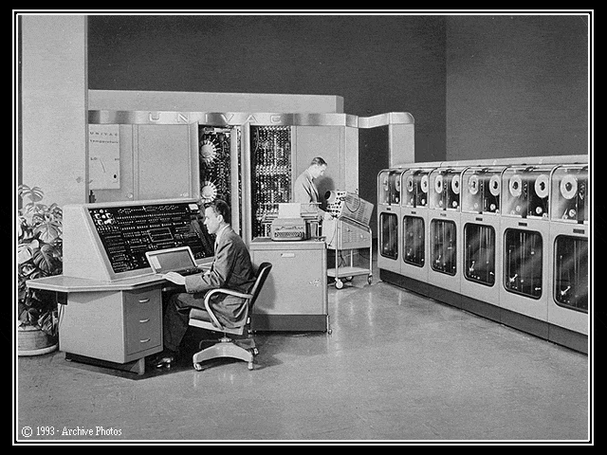
Historical Notes
The term “computer”, until fairly recently, was taken to mean a mainframe system (Big Iron) but nowadays we would call this a networked or Multi-user system.

Slide 8
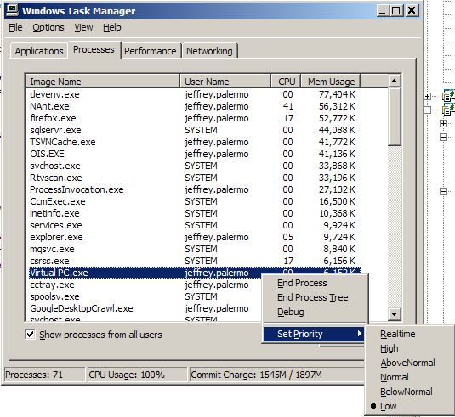
Single-Processor Multi-User System
Single Processor systems have only a single processor or CPU
Processor time is split between applications and/or users by allocating a tiny amount of time to each user in turn
This time-slicing gives the impression that the processor is doing many different things at once

Slide 9
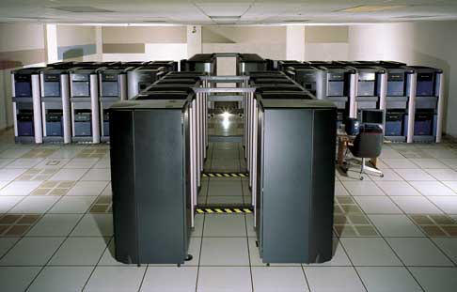
Multi-Processor Multi-User System
Multiple Processor systems have more than one processor
This improves performance – why?
This SGI 512 CPU Origin 2000 system, as used by NASA, has 32 powerful CPUs performing at up to 60 billion floating-point operations per second (60 GFLOP/sec).
http://ameslib.arc.nasa.gov/randt/1999/aero/revol24.html

Slide 10
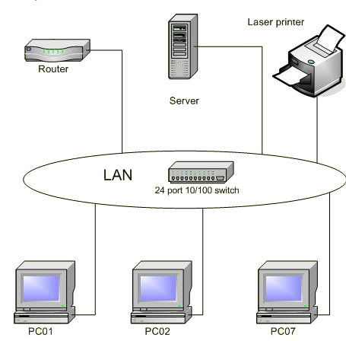
Networked Multi User System
Networked Systems consist of several computers connected together to form a Local Area Network (LAN).
Networked computers can be connected by copper cables, fibre optic cable or wirelessly.

Slide 11
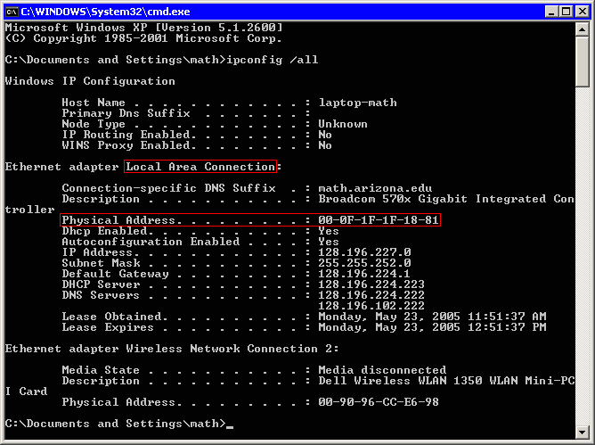
Network Operating Systems
This screen shows the network settings of a PC on a LAN

Slide 12
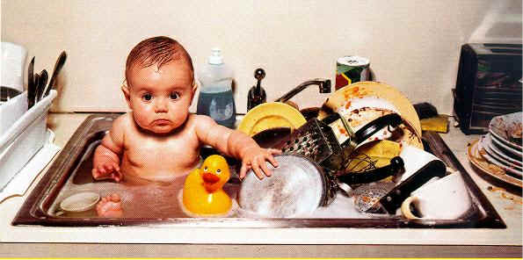
Multi-Tasking Multi-User
Multi-Tasking Systems are those which can apparently carry out several tasks simultaneously

Slide 13
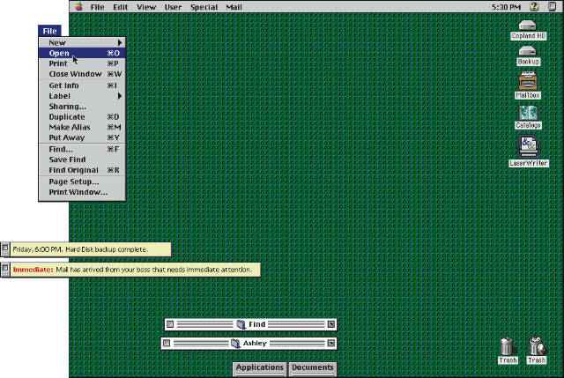
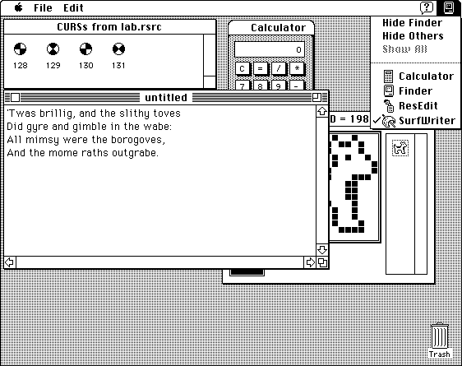
Multi Tasking Strategies
Pre-emptive multi-tasking, where the OS handles the switching of resources between tasks
Co-operative multi-tasking, where each task relinquishes control at an appropriate stage

Slide 14
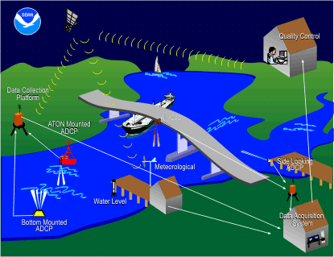
Real-Time Systems
Real Time Systems are used for direct control over electromechanical equipment, reacting to changing situations instantaneously, i.e. in "real time".
This real-time oceanographic data program is used to ensure safe and efficient navigation within U.S. waters.
http://tidesandcurrents.noaa.gov/ports.html

Slide 15
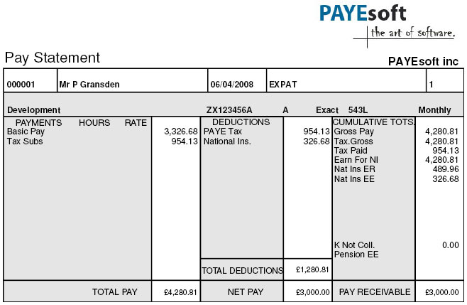
Batch Systems
Batch Systems are used for running large batch operations. These are often run as overnight or background processes.

Slide 16
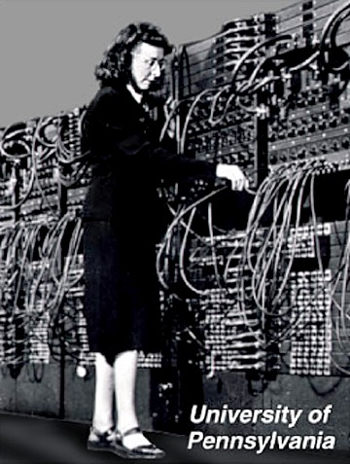
A Layered Operating System
The operating system is generally the most complex item of software on a computer, as well as the most important. Very early computers ran the Operating System in the same space as the other data and programs; nowadays, the OS is kept separately.

Slide 17
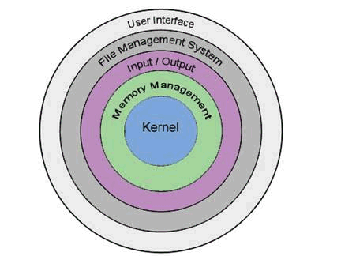
The Five Layers
User Interface
File Management System
Input / Output
Memory Management
Kernel
The Kernel has the greatest level of protection, the User Interface has the least

Slide 18
The User Interface
The User Interface is the layer which allows the user to interact directly with the operating system.
Command Line Interface (CLI) is where the user types in commands at a prompt on the screen.
Graphical User Interface (GUI) is where the user can point and click at icons, scrollbars, boxes and hyperlinks.

Slide 19
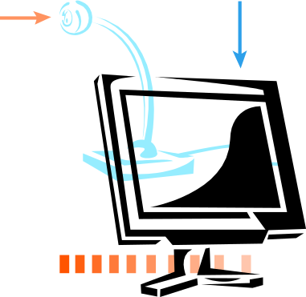


The User Interface
The user interface enables the user to interact with the system, using both input and output devices.

Slide 20
The User Interface
The user interface allows the user to load and run programs.
It allows the user to modify system settings, control system functions and request information.
The UI can be highly customised to suit the individual user.
There are two distinct types of UI.

Slide 21
Command Line Interface
Older operating systems only had CLI interfaces – the user had to type commands in at a prompt on the screen (typically C:>).
It is still possible to use a command-line interface to Windows (7, 8…) by using the a Command Prompt, typing ‘cmd’ in the search next to Start to display the command screen.
Other Operating Systems such as UNIX and Linux still use CLIs on occasion.

Slide 22
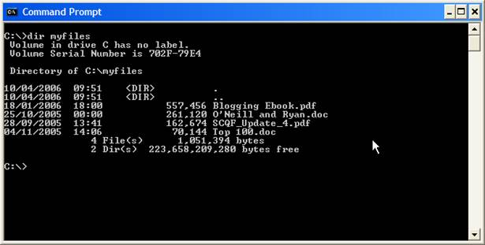
Command Line Interface

Slide 23
Command Line Interface
A switch is used to modify the way a command executes or how it displays its output. The command -
C:> dir windows /p
lists the files in the windows folder, but if there are too many to fit on the screen it pauses its output until a key is pressed.

Slide 24
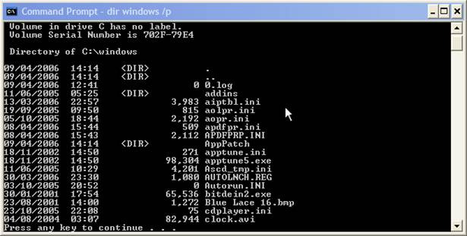
Command Line Interface

Slide 25
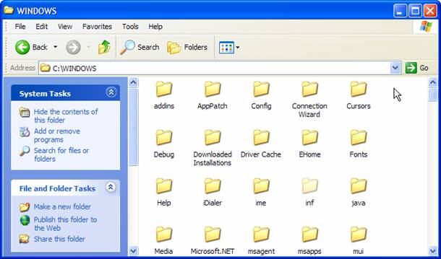
Graphical User Interface
A typical GUI interface will use dialogue boxes, checkboxes, radio buttons, list boxes, edit boxes, scrollbars and buttons. This is sometimes called a WIMP interface (Windows, Icons, Menus, Pointers)

Slide 26
Discussion
What are the advantages of a layered Operating System?
Which is easiest to learn – CLI or GUI? Why?
Can you give examples of customisation of a GUI?
The term API stands for Application Programming Interface. What do you think this is, and why is it useful?

Slide 27
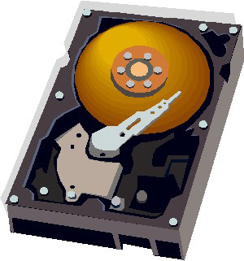
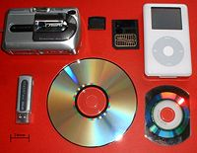
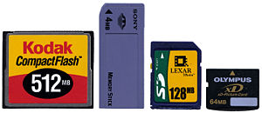
The File Management Layer
The File Management Layer is responsible for organising and managing the storage of data on permanent media.
Permanent media refers to either removable media, or FDD (hard disk).

Slide 28
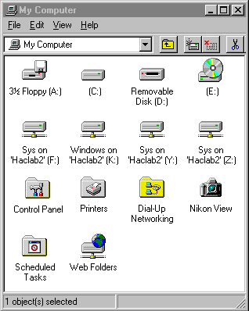
Logical Drives
Each storage device on a computer has a drive letter assigned to it.
Typically, A: is the floppy drive
C: is the Primary Hard Drive
D: is the CD drive
…and so on. Every time you add a new drive, Windows assigns the next letter to it
So on a machine with two hard drives, they would probably be C: and D:, and the CD drive would become E:

Slide 29
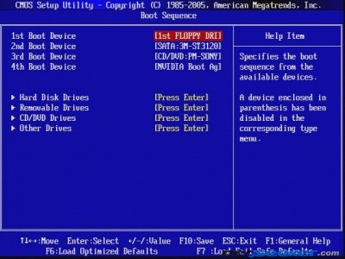
Bootable Drives
The term bootable means that the OS can be started (booted) from them.
The primary boot device is usually the Primary Hard Drive C:, but computers can boot from any drive that contains an OS
The order in which the computer searches for an OS to boot from is known as the boot sequence
The boot sequence can be altered in the BIOS settings

Slide 30
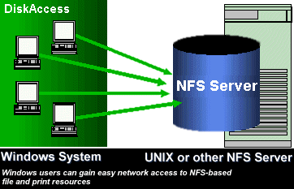
Network File System
A network file system is any computer file system that supports sharing of files, printers and other resources over a computer network
The first file servers were developed in the 1970s
In 1985 Sun Microsystems created Network File System (NFS) which became the first widely used network file system

Slide 31
File Locking
In a multi-user system, it is possible that two users may try to access the same file at exactly the same time. This could lead to data corruption.
When someone tries to open a shared file, the OS checks to see whether the file is already open. If it is, the second user cannot amend it. They may, however, open a read-only copy.
File locking is simple to implement, but means that the file is unavailable for others while already in use.
Large files are often split up into sections, so that only parts of it may be locked. This is called as record locking

Slide 32
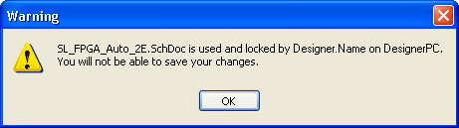
File Locking
A network file system must allow multiple client processes to access and update the same files
Updates to the file from one client should not interfere with access and updates from other clients
Locking may be either built into the file system or be provided by an add-on protocol.

Slide 33
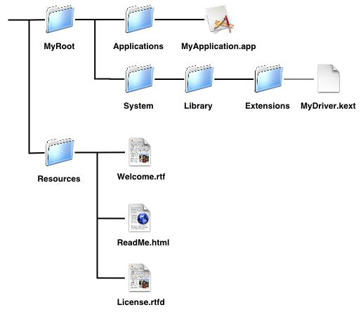
File Hierarchy
Every storage device has a root directory
All other files and directories are stored within the root directory
Directories can be nested, meaning it is possible to store sub-directories, as well as files

Slide 34
Logical Structure
Each file and folder must have a name which is unique at that level - it is not possible to have two files with the same name in the same folder
Each user on the system has their own home directory
Users can also set permissions specifying who else is permitted to read, write or execute files within their directory

Slide 35
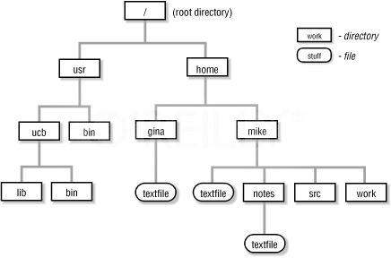
Logical Structure (UNIX System)

Slide 36
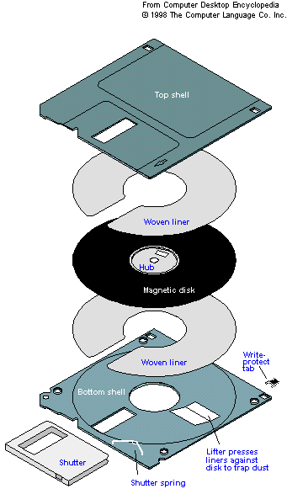
Physical Structure – Floppy Disk
A floppy disk is a circular sheet of plastic, coated with ferrous compound
It is divided up into 80 concentric tracks, each of which is subdivided into 18 sectors
This gives 1,440 clusters, each uniquely identified by its track and sector position
Each cluster holds 512 bytes of data, giving a total capacity of 1.44 MB

Slide 37
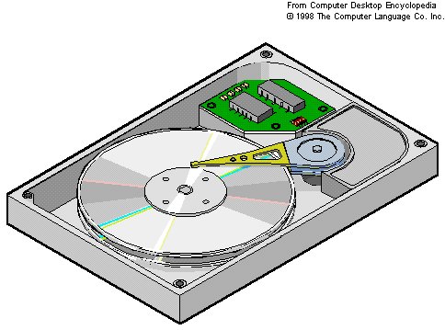
Physical Structure – Hard Disk
A hard disk contains a stack of circular platters (metal or toughened glass) mounted on a spindle
Electromagnetic read/write heads pass across each platter
While the platters spin, the heads can move in or out towards the desired location

Slide 38
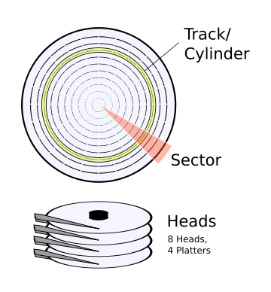
Hard Disk Structure
Each platter is divided into thin concentric bands known as tracks
The tracks are further subdivided into sectors, each 512 bytes in size
A group of tracks which have the same track number, but are on different platters, is sometimes referred to as a cylinder
There are normally 1024 tracks on a hard disk, numbered from 0 (at the edge of the disk) to 1023 (near the centre).

Slide 39
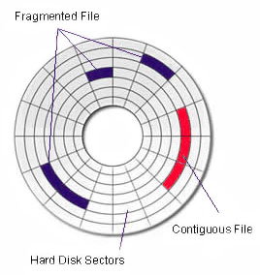
Hard Disk Structure
The higher numbered tracks near the middle are shorter than those near the edge of the disk
To get the same amount of data on each track, the higher numbers are more densely written
One side of the first platter is used to store disk controller instructions, that are used to operate the read/write heads
As sectors are only 512 bytes long, most files require more than one unit of space

Slide 40
Blocks and Clusters
The File Management Layer is responsible for allocating storage areas on the disk
It group a number of storage areas together into blocks or clusters of a larger size
These blocks made up from contiguous areas on the disk
Files are stored in units of blocks, rather than sectors, and these blocks are identified to the file system by a number, from 0 up to the total number of blocks on the disk

Slide 41
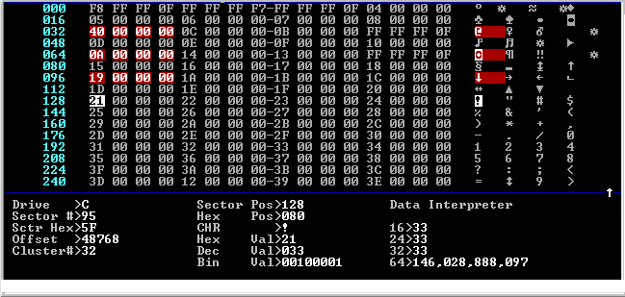
File Allocation Tables
Information about each directory is stored in a table, held on disk and maintained by the file management layer
Each record stores the file name and it’s attributes, the size of the file and it’s location on the disk

Slide 42
Files larger than 1 cluster
Files may be stored contiguously, but this may not always be possible for large files. A free space map must be kept showing which areas are used and which are free – this occupies additional disk space and slows down the file system
Each cluster may also contain a pointer to the next one, creating a linked list. This system also needs to maintain a free space map so we know which clusters are available for allocation to a new or enlarged file.
An index table may be used showing the status of each cluster; the start cluster number from a file's directory points into the table, which points back to the next cluster used, and so on

Slide 43
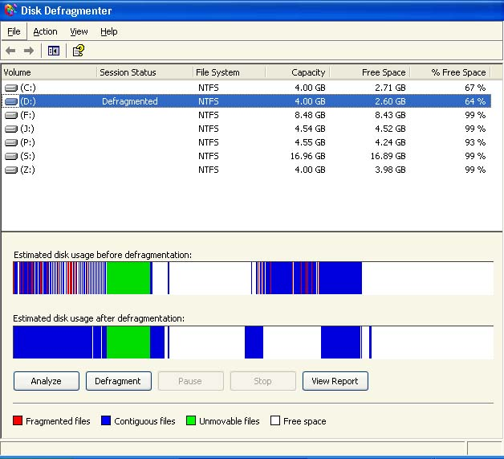
Disk Defragmentation
When files are deleted and new files written to the media, fragments tend to become scattered over the entire disk
This makes reading and writing slower on storage devices
When the system is taking a long time to seek out the following clusters, the volume will have to be defragmented

Slide 44
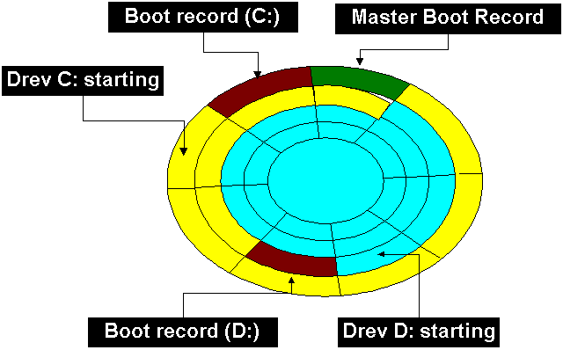
FAT File System
The File Allocation Table (FAT) file system works by storing a table and the root folder in a fixed location, so that the files needed to start the system can be located easily

Slide 45
FAT12, FAT16 and FAT32
There have been several versions of FAT, including FAT12, FAT16 and FAT32
File space on a FAT volume is allocated in clusters. The default cluster size depends on the size of the volume
When a new file is created it is given the first available location on the volume. The starting cluster number is the address of the first cluster used by the file. Each cluster contains a pointer to the next cluster in the file, or an indication (0xFFFF) that it is the end of the file

Slide 46
FAT Folder Structure
Each 32-byte Folder Entry includes the following information:
  Name (eight-plus-three characters)
  Attribute byte (8 bits)
  Create time (24 bits)
  Create date (16 bits)
  Last access date (16 bits)
  Last modified time (16 bits)
  Last modified date (16 bits)
  Starting cluster number in FAT table (16 bits)
  File size (32 bits)

Slide 47
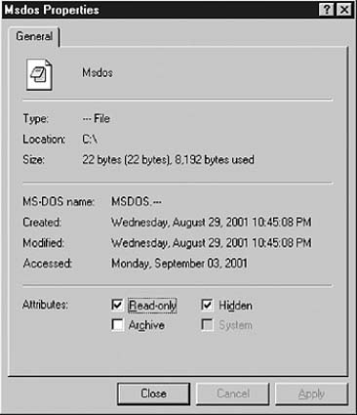
File Attributes
A FAT file also has four attribute bits that can be set by the user: archive, system, hidden and read-only.
FAT32 is a derivative of the FAT file system that supports drives with over 2GB of storage. The largest possible file for a FAT32 drive is 4GB minus 2 bytes.

Slide 48
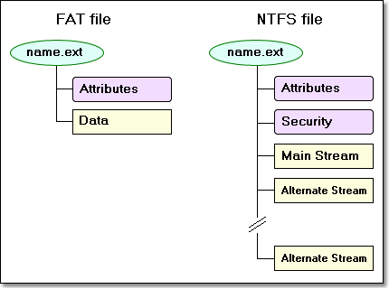
NTFS File System
NTFS file system is more secure and reliable than FAT; it supports data access control, ownership privileges, file compression and data encryption
The first item of information on an NTFS volume is the Partition Boot Sector
This is followed by the Master File Table (MFT) which holds records of the files on the volume

Slide 49
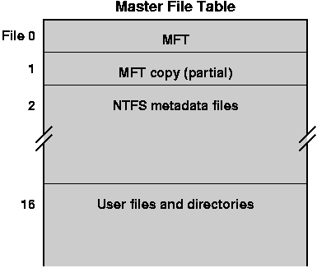
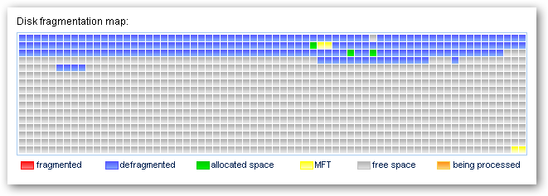
NTFS File System
The first record describes the MFT itself and is followed by a MFT mirror record which duplicates the same information
The locations of the data segments for both the MFT and MFT mirror file are stored in the boot sector and a duplicate of the boot sector is held at the logical centre of the disk

Slide 50
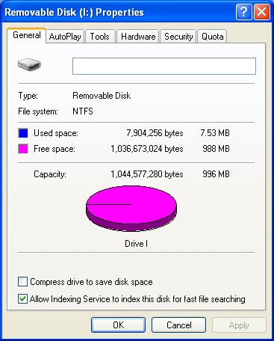
Master File Table
NTFS file access is very fast in comparison to FAT
Directory records are stored within the master file table just like file records, but instead of data, they contain index information
Small directory records can be stored entirely within the MFT structure. Large directories are organized into trees consisting of records with pointers to external clusters containing directory entries

Slide 51
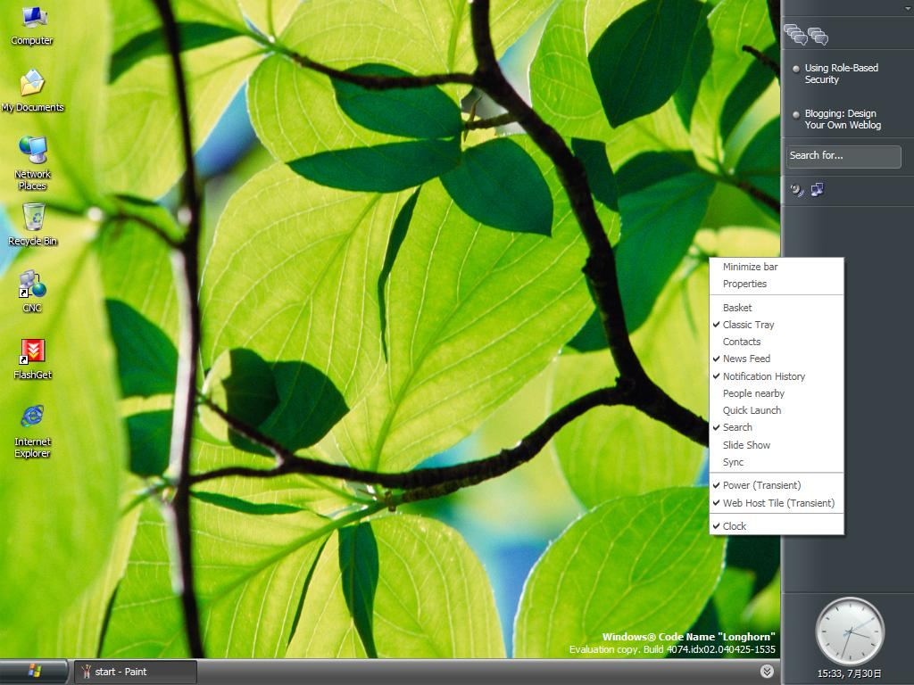
Win FS for Vista
Windows Future Storage is a new Windows storage subsystem, currently being developed by Microsoft for the Windows Vista Operating System
It acts more like a relational database than a simple list of file names, using indexed and searchable context and keyword information.

